Slide 1

Rest API Development
REST Services of Ecommerce website with Spring Boot using Microservises Architecture

Slide 2

OUR GOAL:
Building a Rest API’s for a website using Java, The intention is to reproduce the backend model of a website that is already used by our generation frequently. As a developer, we are required to think out of the box, plan your development strategy and try developing API’s in a way that they support maximum number of features being used in the website and maximizing results from each API, reduce any redundancy, We will also use Microservices Architecture and the Spring Cloud’s for building the API and the API’s can be tested through Swagger.

Slide 3
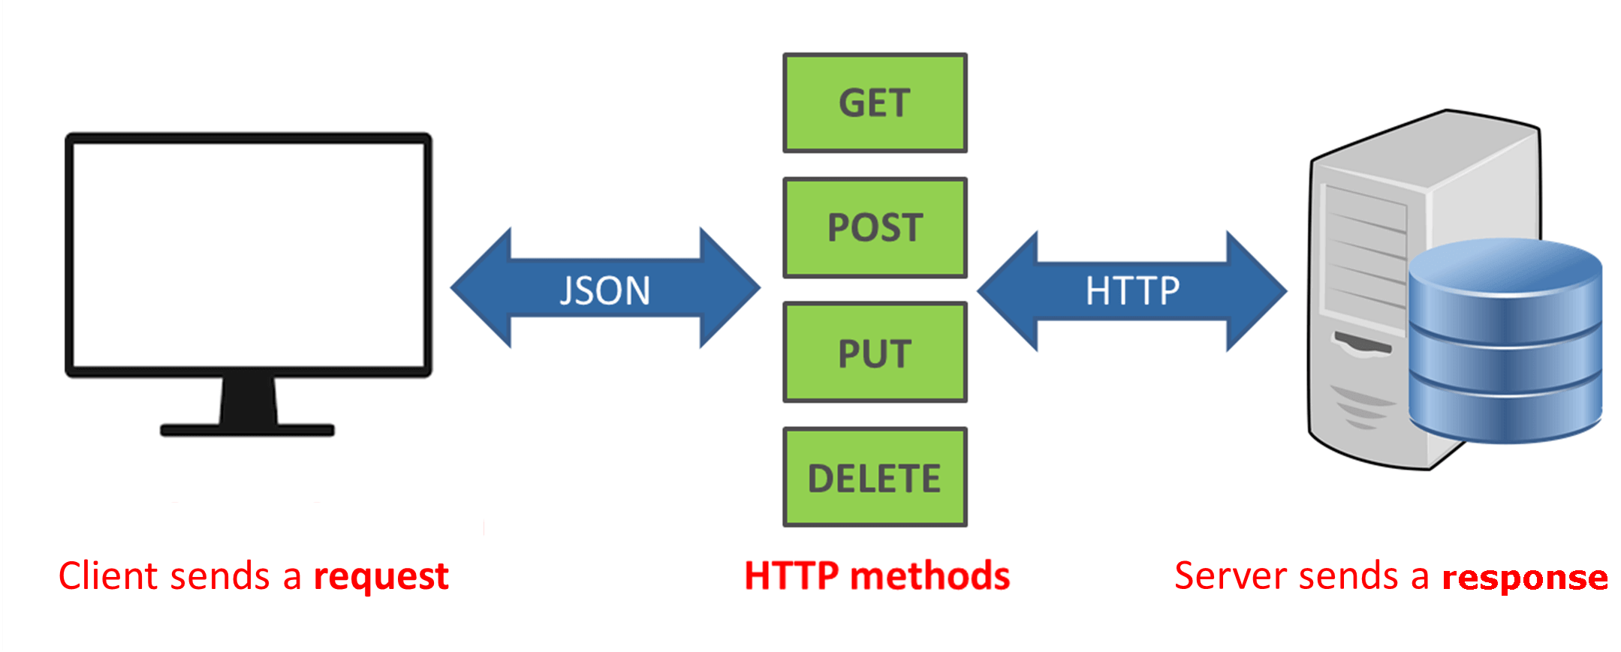
WHAT IS REST API?
RESTful API uses existing HTTP methodologies defined by the RFC 2616 protocol. They use GET to retrieve a resource; PUT to change the state of or update a resource, which can be an object, file or block; POST to create that resource; and DELETE to remove it.

Slide 4
TECHNOLOGY USED:
FRONTEND:
TECHNOLOGY | USES
JAVASCRIPT | JavaScript is a client scripting language which is used for creating web pages and Web Applications.
HTML | HTML is heavily used for creating pages that are displayed on the world wide web.
CSS | CSS is the language for describing the presentation of Web pages, including colors, layout, and fonts.

Slide 5
BACKEND:
TECHNOLOGY​ | USES​
WEBMVC​ | Spring Web MVC framework provides Model-View-Controller architecture and ready components that can be used to develop flexible and loosely coupled web applications.The Model encapsulates the application data and in general they will consist of POJO.​
SPRING CLOUD(NETFLIX EUREKA)​ | In this a client retrieves a list of all connected peers of a service registry and makes all further requests to any other services through a load-balancing algorithm.​Spring Cloud provides tools for developers to quickly build some of the common patterns in distributed systems (e.g. configuration management, service discovery, circuit breakers, intelligent routing, micro-proxy, control bus, one-time tokens, global locks, leadership election, distributed sessions, cluster state).
SPRING BOOT​ | The main goal of Spring Boot Framework is to reduce Development, Unit Test and Integration Test time and to ease the development of Production ready web applications very easily.​

Slide 6

TEAM MEMBERS:
NAME: VARUN MEHROTRA
ADMISSION NO: 17SCSE101440
NAME: MINAL GARG
ADMISSION NO: 17SCSE101666

